Slide 1
IoT sensor integration and back-end development for Sequoia
Team: sdmay19-36
Advisor: Daji Qiao
Client: Andrew Guillemette: NxGencare
Team Website: http://sdmay19-36.sd.ece.iastate.edu/

Slide 2
Vision
[1]
[2]
Notes:
As our loved ones begin to age, we want to ensure that they can experience life to the fullest. They love us, and we love them, so we want to ensure that we are always keeping a watchful eye. We hope to enable our loved ones to remain close with the family, while experiencing the fullest quality of life as the years go by. Happy. Healthy. And Free to live their live. We hope to aide this process for all.

Slide 3
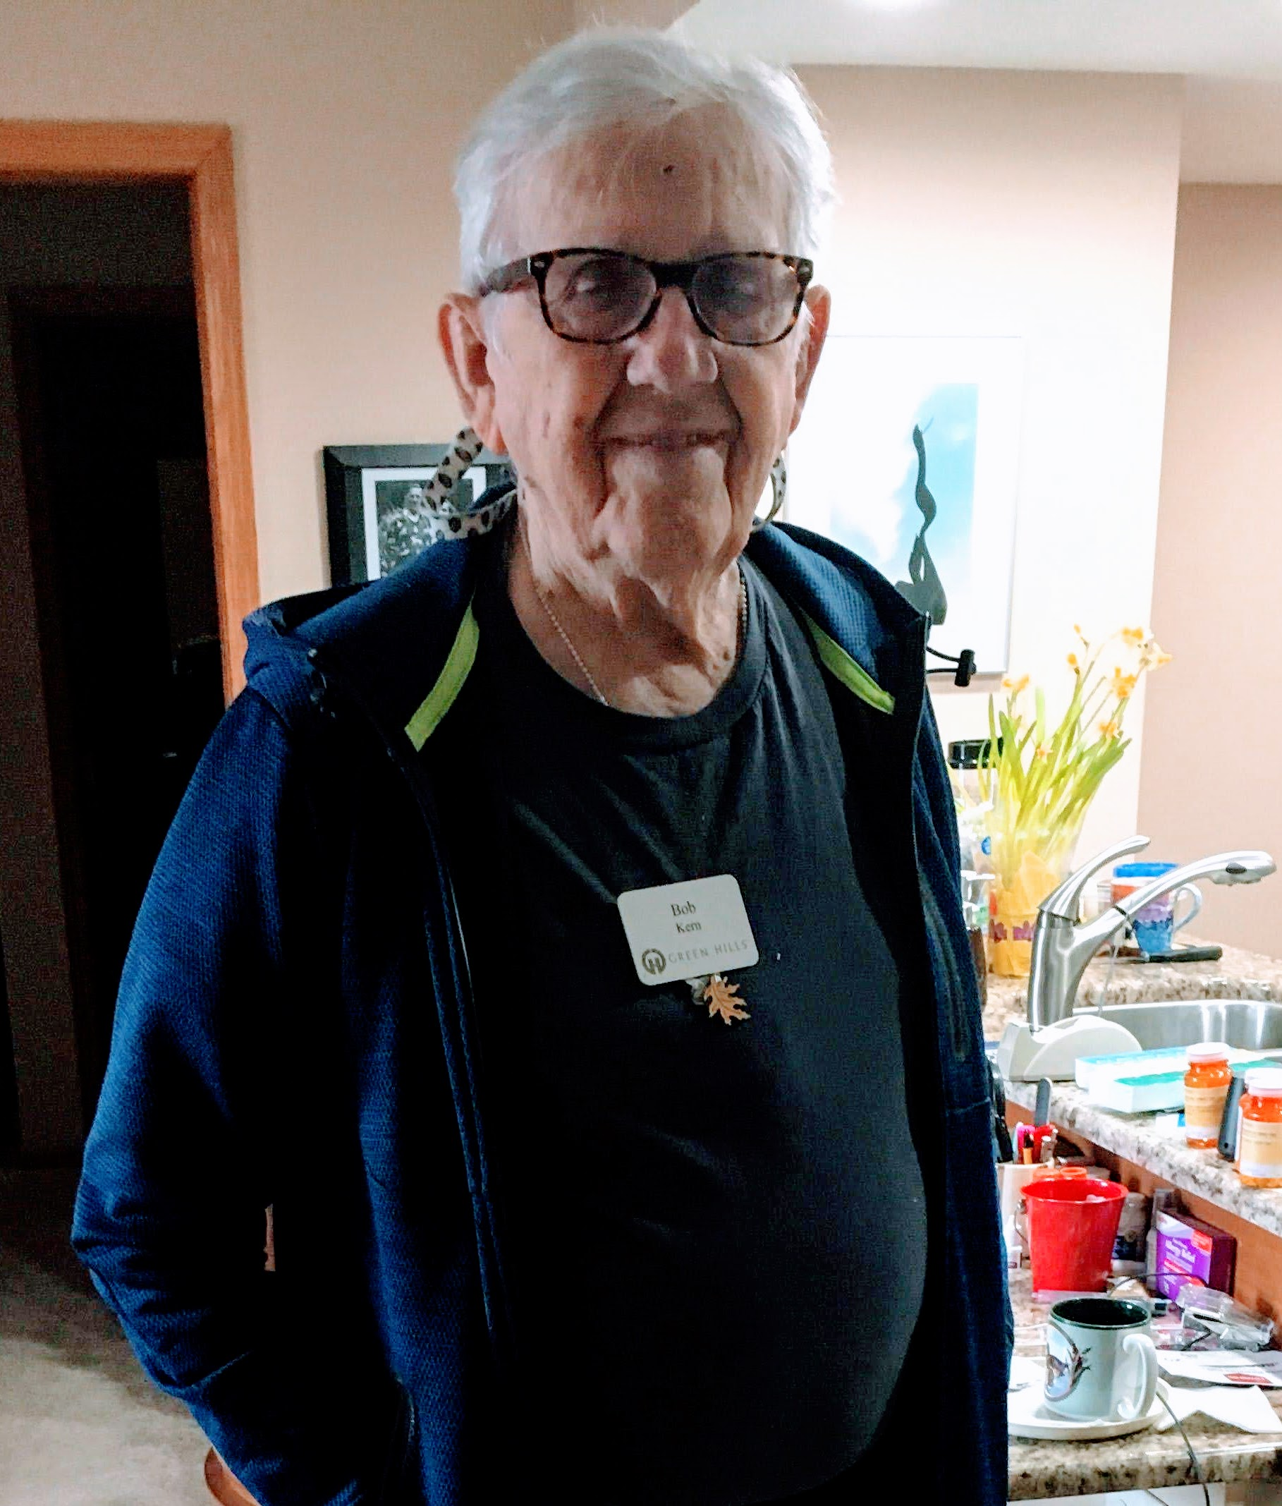
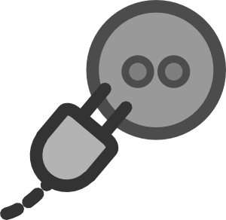
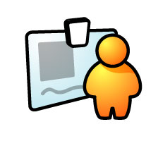
Problem Statement
Sensor Data
Behavioral Profile
[5]
[4]
[3]
Notes:
This is Bob. He is 95 and was the first resident at Green Hills retirement community, and he volunteered to be in the piolet program for the Sequoia project. With his whole family out of state we want to keep Bob healthy so that we can continue living at green hills. What the sequoia project has done for Bob is put sensors in his apartment to collect data about his habits, specifically in the kitchen. In the future this data will be used to build a behavioral profile for Bob so that we can monitor him, and alert a loved when his routine changes enough to possibly indicate a health issue.

Slide 4
Tasks
Android app data display and functionality
Created backend for sensor data
Smart plug
Smartwatch
Flow meter
[6]
[7]

Slide 5
Functional Requirements
Smart Plug, Flow Meter, and Smart Watch Monitoring
Utilizing a Smart Hub, daily health events, such as using microwave, getting a cup of water, and smart watch analytics are delivered to a data analysis server.
Data Analysis Server
An analytics server accepts incoming health events and distributes the information to the various systems using it (Mobile App, Webpage), while analyzing the data and providing helpful information to the user.
Notes:
Sensor Hub
Flow Meter
Smart Outlet
Smart Watch
All of these transfer daily health events to create a behavioral profile.
AWS Server accepts incoming health events an distributes them to l

Slide 6
Non-functional Requirements
Scalability
3rd Party products used are readily available for purchase in large quantities to be scaled to large amounts of customers.
Wireless
Implemented systems operate wirelessly to transfer data and communicate with the smart hub and user.
Independent
The product requires no user interaction or maintenance to continue monitoring and sending data. Accepts updates remotely.

Slide 7
Design Plan

Slide 8
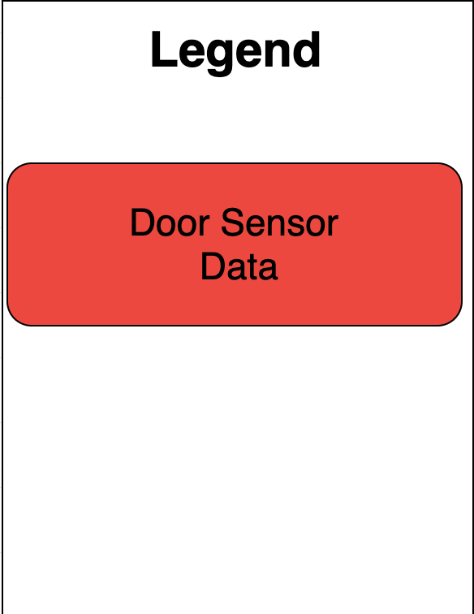
Pre-Existing Architecture Diagram
Notes:
As stated, we are building on a previous team’s project. Their project consisted of multiple door sensors within Bob’s apartment to track when he open or closed a kitchen cabinet door. This data was then sent from a raspberry pi that acts as a sensor hub to our backend server through a JSON request carried through the wifi network.

Slide 9
Architecture Diagram
Notes:
To extend this project, we added three new sensors. A smart watch to detect the heart rate and get the step count of the resident. We have also added smart plugs to determine when certain electrical devices are used in the apartment and for how long. Finally we added a flowmeter sensor to determine whether the hot or cold tap was used and how much water was drawn. The data from the smartwatch sends data directly to the server. The other two sensors send data through the sensor hub to join the data from the door sensors.
Next we have added an android application that is able to display the data collected in the server. This communication is done through JSON.
Finally the next team that takes over our project will then take our data collection system and try to find ways to predict eating habits of the resident.

Slide 10
Implementation Technologies Used
Sensors and Hub
Smart Plugs
Python
Node.JS
Backend Server
Smart Watch and App
Spring MVC
Android Studio
Notes:
*Note – don’t forget to explain why we selected technology.
Python
Python HTTP Server running on local sensor hub to receive HTTP requests from flow meter & pre-existing sensors.
NodeJS
NodeJS script used to grab data from TP-Link API and trigger events when Smart Plugs are in use.
Java Spring
External API hosted on AWS Server that the sensor hub & smart watch send events and data too.
Android
Used for Android App and WearOS Smartwatch App.
Python – Was preexisting component from previous years team.
NodeJS – Only had one means of using a reverse-engineer’ed TP-Link API, so we were limited to NodeJS for this component, along with previous use.
Java Spring – Inherited from previous group, so instead of using a different technologies we continued to add on to it.
Android – We went with Android as hardware tended to be cheaper, alongside the smart watch we selected to use only used WearOS

Slide 11
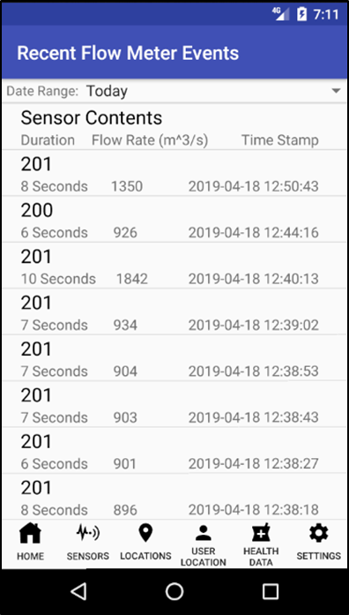
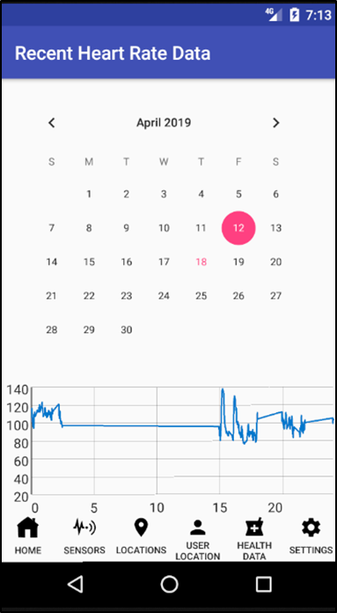
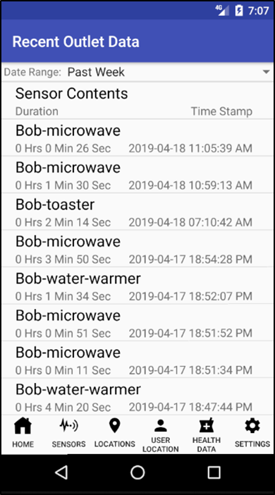
Implementation (Android App)
App is used to display collected data from all sensors

Slide 12
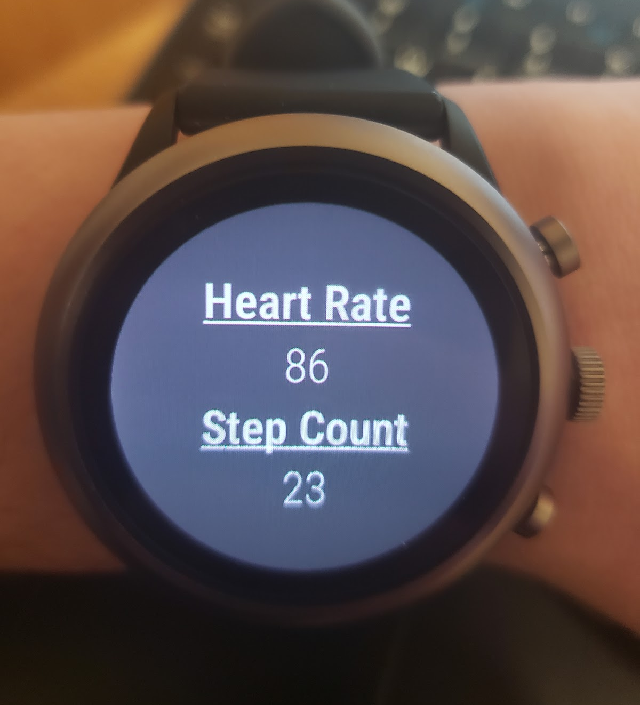
Implementation (Smart Watch)
Measuring
Collecting
Step Count
Display Data
Send Data
To Server
Heart Rate
[8]
[3]
[9]

Slide 13
Implementation (Smart Plug)
Smart Plug Connected Device
Not able to access directly
Device Energy Statistics
TP-Link
Servers
[10]
Notes:
The smart plugs usually send data from the plug straight to TP-Link Servers with no developer API to get data from plug. The company wants you to view data only from their servers.

Slide 14
Implementation (Smart Plug)
Project
Backend Server
Smart Plug Connected Device
Device In-Use
Event
Device Energy Statistics
TP-Link
Smart Home API
TP-Link
Servers
[10]
Notes:
We found an open source API
The API is able to make a socket connection and intercept packets from the plug
When the plug reaches past a certain power threshold, it will trigger a Device In-Use Event that is sent to our servers
Once it reaches the server, we will do processing to combine corresponding in-use events into a smart plug duration.

Slide 15
Implementation (Sensor Hub)
Using a Raspberry Pi
Connects to local network
Collects data from sensors around the home
Sends collected data to AWS backend server
Running a local NodeJS script
Running a local HTTP server
[11]
Notes:
Image: http://www.raspberrypi.org

Slide 16
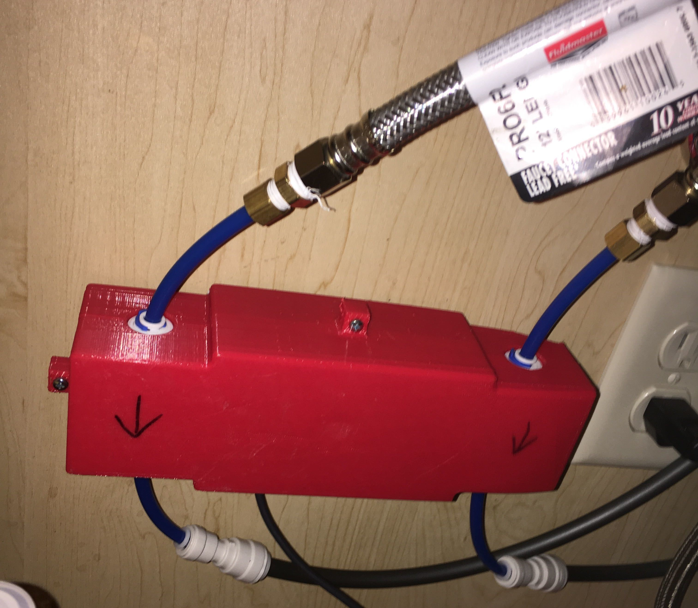
Implementation (Flow Meter)
Collect Water Usage
Send Data
To Server
[12]
[9]

Slide 17
Implementation (AWS Server)
Hosts Java Spring API endpoints.
Listens for incoming requests from sensor hub, smart watch, and android app
Processes incoming data to compute the time duration of each event.
Stores data on MySQL Database hosted on server.

Slide 18
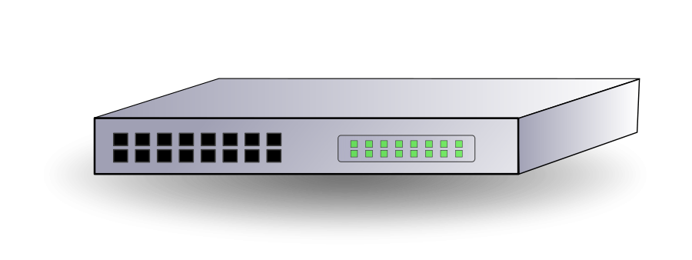
Standards/Best Practices
Part 10471: Device specialization
Independent living activity hub
Use food safe products (NSF certified)
[13]
[14]

Slide 19
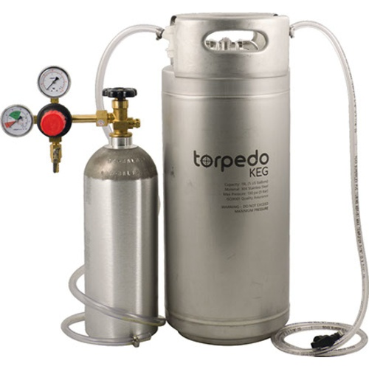
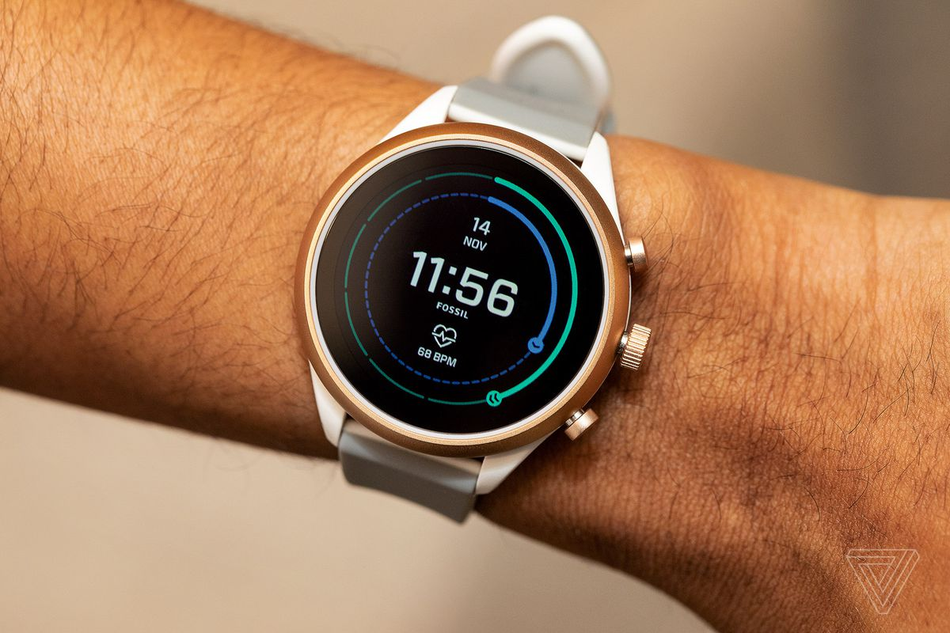
Test Plan
Test Personal Appliances
Self-Built Flow System
Personal Body Data Collection
[15]
[16]
[17]

Slide 20
Integration Testing
Smart Plugs and Flow Meter
Development
Office
Test
Environment
Apartment
Installation
Smart Watch
Development
Testing
with Team
Field
Testing

Slide 21
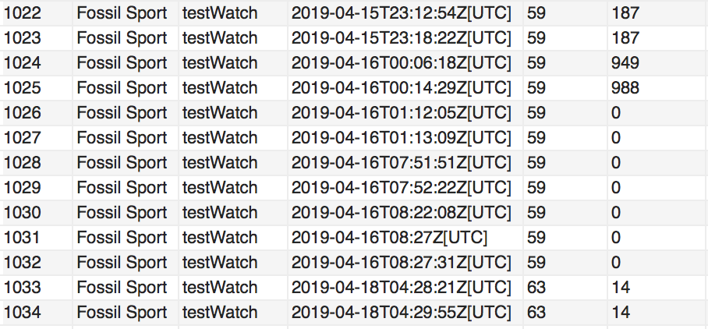
Test Results
Smart Plug Data
Smart Watch Data
Flow Meter Data

Slide 22
Schedule
Proposed Schedule
Actual Schedule

Slide 23
Risks
Expected
Unexpected
Project Inheritance
Heart rate data varies with how its worn
[18]
Changing
Requirements
[7]

Slide 24
Task Distribution
Cody: Research and Smartwatch backend development
Guan: Flow Meter development and implementation
Josh L: Research and Smartwatch frontend development
Josh H: Smart Plug Event recording and Duration calculations
Justin: Smart Plug Development & AWS Server Management
Mike: Team Manager, Android App developer

Slide 25
Future Work
Machine Learning
Meaningful insights from health data
Apple Watch compatibility
RightMinder fall detection
Indoor location tracking
Guest tracking and data separation
Additional sensors in the home
HIPAA Security Considerations
[19]
[20]
[21]
[22]
[24]
[23]
Notes:
Images (from left to right, top to bottom)
https://www.123rf.com/clipart-vector/machine_learning.html?sti=lw5n1xrty9q8gszqfy|&mediapopup=55388093
https://www.apple.com/shop/buy-watch/apple-watch-series-3
https://www.seniorsafetyreviews.com/tips/the-definitive-guide-to-preventing-falls-for-seniors/
https://phys.org/news/2018-06-good-bad-tracking.html
https://www.hralleghenies.org/store/p52/GUEST_%2F_Non-Member.html
https://internetofbusiness.com/qa-tiago-rodrigues-wireless-broadband-alliance-on-iot-device-roaming-standards/

Slide 26
Summary
Collect data with sensors
Build a behavioral profile
Keep our seniors healthy
[5]
[7]
[2]

Slide 28
Appendix

Slide 29
Event Recording and Duration Calculations
Smart Plug Event
Smart Plug Duration
Device: A
Device: A
Timestamp: 4-30-19-8:30
Start Time: 4-30-19-8:30
Type: In Use
End Time: 4-30-19-8:35
Duration: 5m
Smart Plug Event
Device: A
Timestamp: 4-30-19-8:35
Type: Not In Use

Slide 30
Flow Meter Internals
Water
Water
Sensor
Raspberry Pi
Sensor

Slide 31
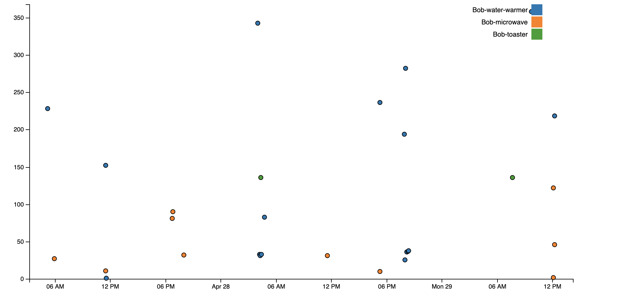
Smart Plug Event Data Visualization
Duration (Secs)
Smart Plug Event start time (4-27-19 - 4:30 pm on 4-28-19)

Slide 32
References Part 2
8. http://clipart-library.com/clipart/71.htm
9. http://clipart-library.com/clipart/119390.htm
10. http://clipart-library.com/clipart/2074552.htm
11. http://www.raspberrypi.org
12. http://clipart-library.com/water-faucet-clipart.html
13. http://clipart-library.com/clipart/2040029.htm
14. http://clipart-library.com/clipart/food-clip-art-7.htm
15. https://www.caesarstoneus.com/media/220558/americas-test-kitchen-credit-steve-klise.jpg
16. https://morebeer-web-8-pavinthewaysoftw.netdna-ssl.com/product_image/morebeer/500x500/15728.jpg

Slide 33
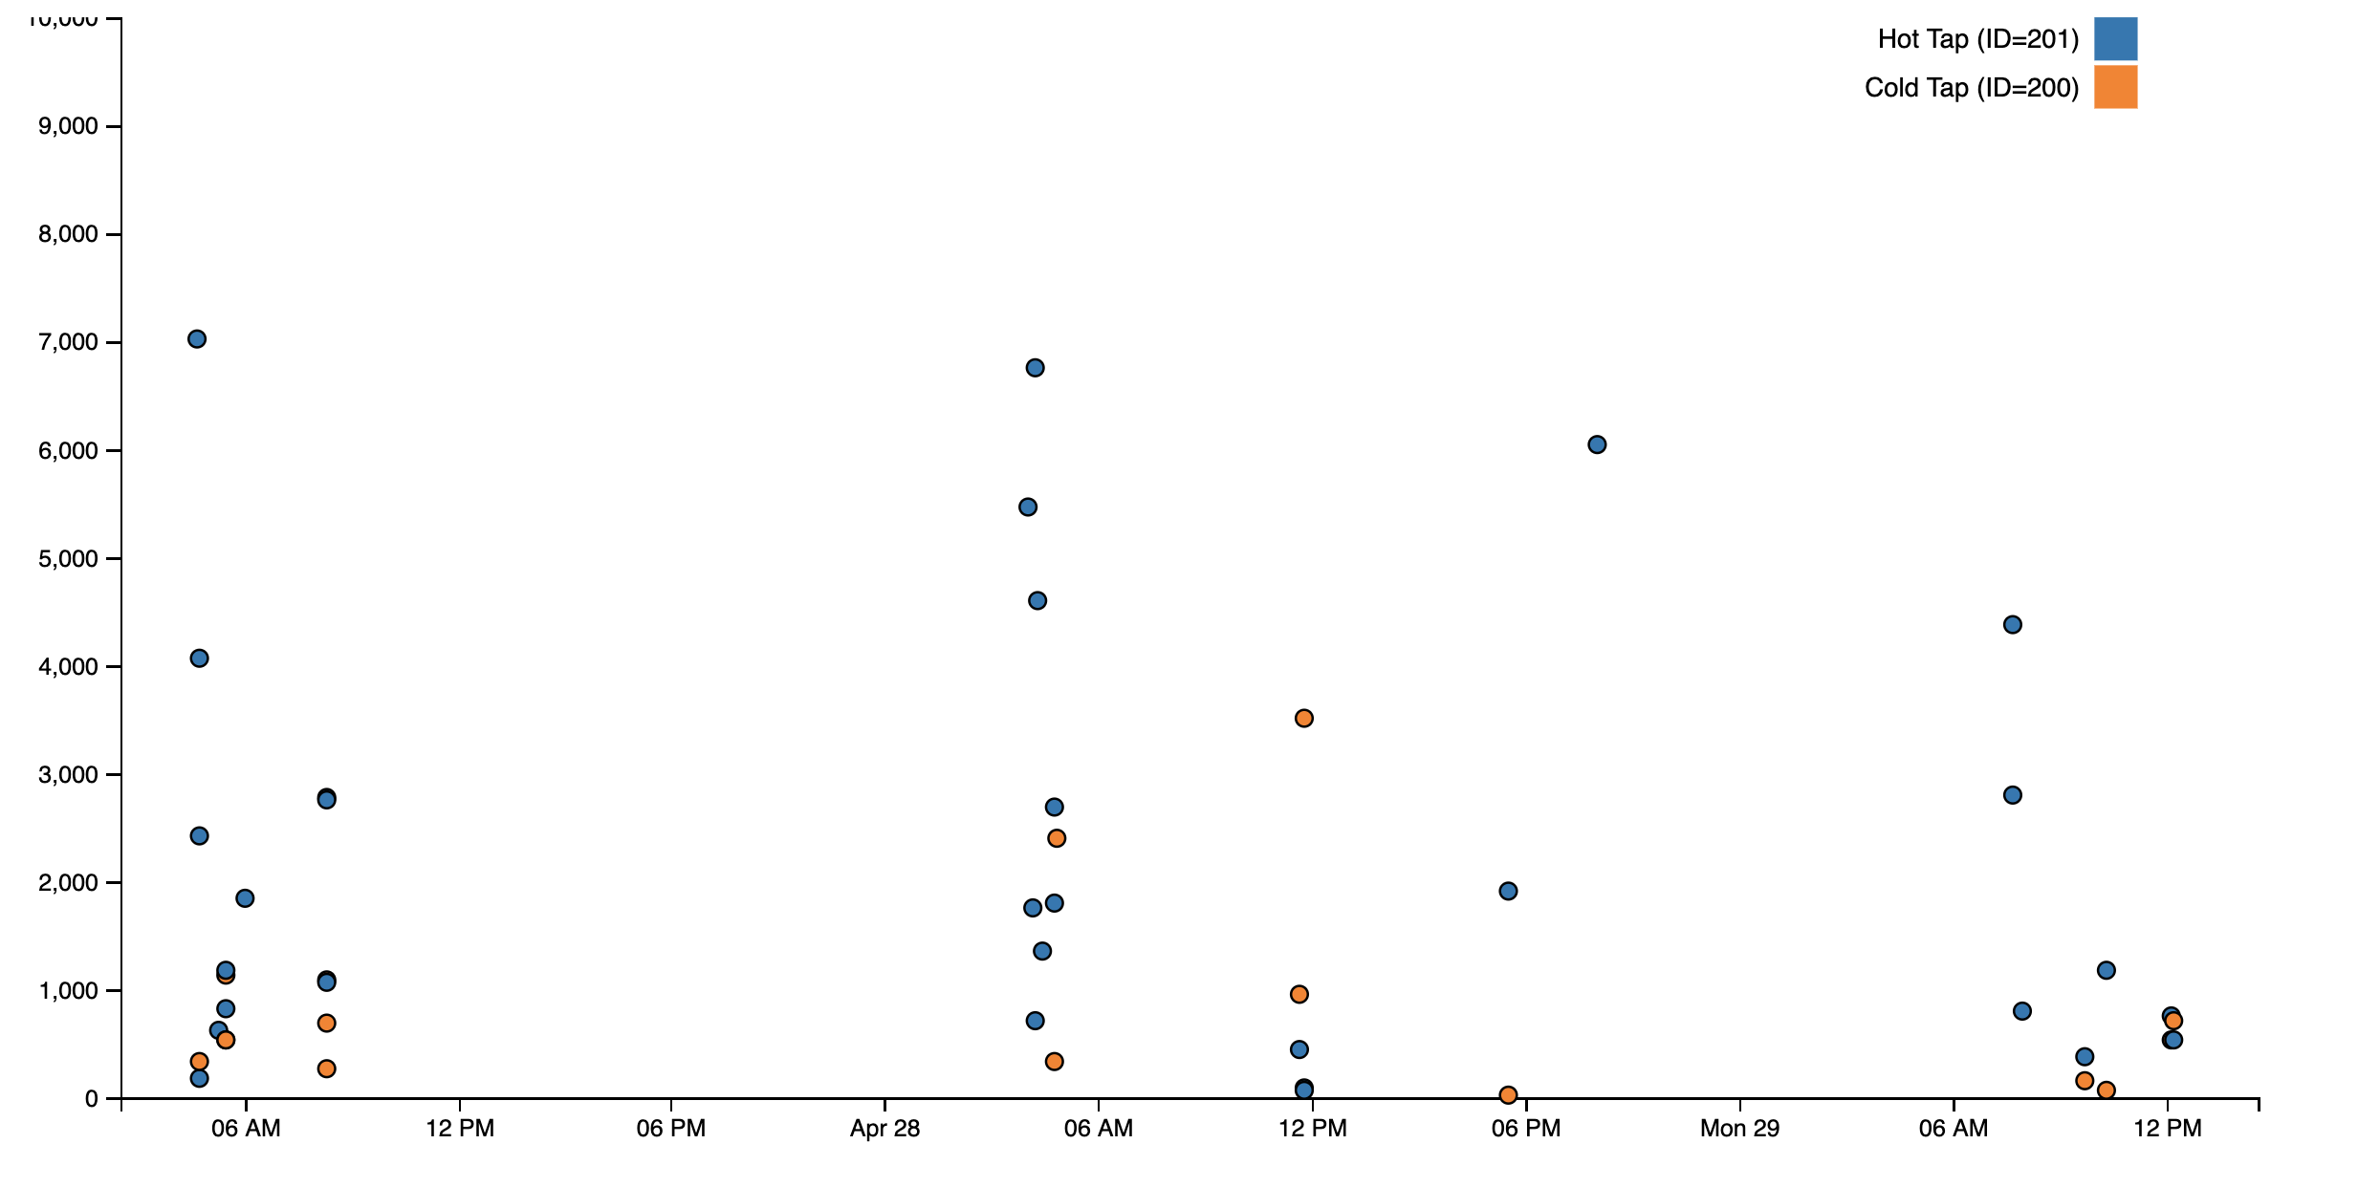
Flow Meter Data Visualization
Amount
Of Water (mL)
Flow Meter start times (4-27-19 - 4:30 pm on 4-28-19)

Slide 34
Event Identification (Behavioral Profile)
Resident Eating Event Likely (Lunch)

Slide 35
References
1. https://burst.shopify.com/photos/senior-using-cell-phone?q=elderly
2. https://www.canva.com/photos/parks-outdoor/MADGx_v8BgY-grandmother-and-grandfather-holding-child-on-their-lap/
3. http://clipart-library.com/clipart/384143.htm
4. http://clipart-library.com/clipart/524021.htm
5. http://clipart-library.com/clipart/295468.htm
6. https://www.kasasmart.com/us/products/smart-plugs/kasa-smart-plug-energy-monitoring-hs110
7. https://www.fossil.com/us/en/products/fossil-sport-smartwatch-41mm-black-silicone-sku-ftw6024p.html?recid=fossil_product--FTW6024P--7.html?recid=fossil_product--FTW6024P--7.html

Slide 36
References Part 3
17. https://cdn.vox-cdn.com/thumbor/4MsTFkyct1IDhaa9ykfAMV-Xv5k=/0x0:2040x1360/1200x800/filters:focal(796x457:1122x783)/cdn.vox-cdn.com/uploads/chorus_image/image/62361130/jbareham_181114_3085_0015.0.jpg
18. https://all-free-download.com/free-vector/download/multiple-users-clip-art_7523.html
19. https://www.123rf.com/clipart-vector/machine_learning.html?sti=lw5n1xrty9q8gszqfy|&mediapopup=55388093
20. https://www.apple.com/shop/buy-watch/apple-watch-series-3
21. https://www.seniorsafetyreviews.com/tips/the-definitive-guide-to-preventing-falls-for-seniors/

Slide 37
References Part 4
22. https://phys.org/news/2018-06-good-bad-tracking.html
23. https://www.hralleghenies.org/store/p52/GUEST_%2F_Non-Member.html
24. https://internetofbusiness.com/qa-tiago-rodrigues-wireless-broadband-alliance-on-iot-device-roaming-standards/

